Slide 1
Session 1
Software QA and Automation
Type of tests [Functional / Non functional]
Test-Case / Test-Suite / Test-Scenario
Test Tools and Frameworks
What is Selenium and how it works?
Sample of Automation with Selenium

Slide 2







Test tools and Frameworks

Slide 3
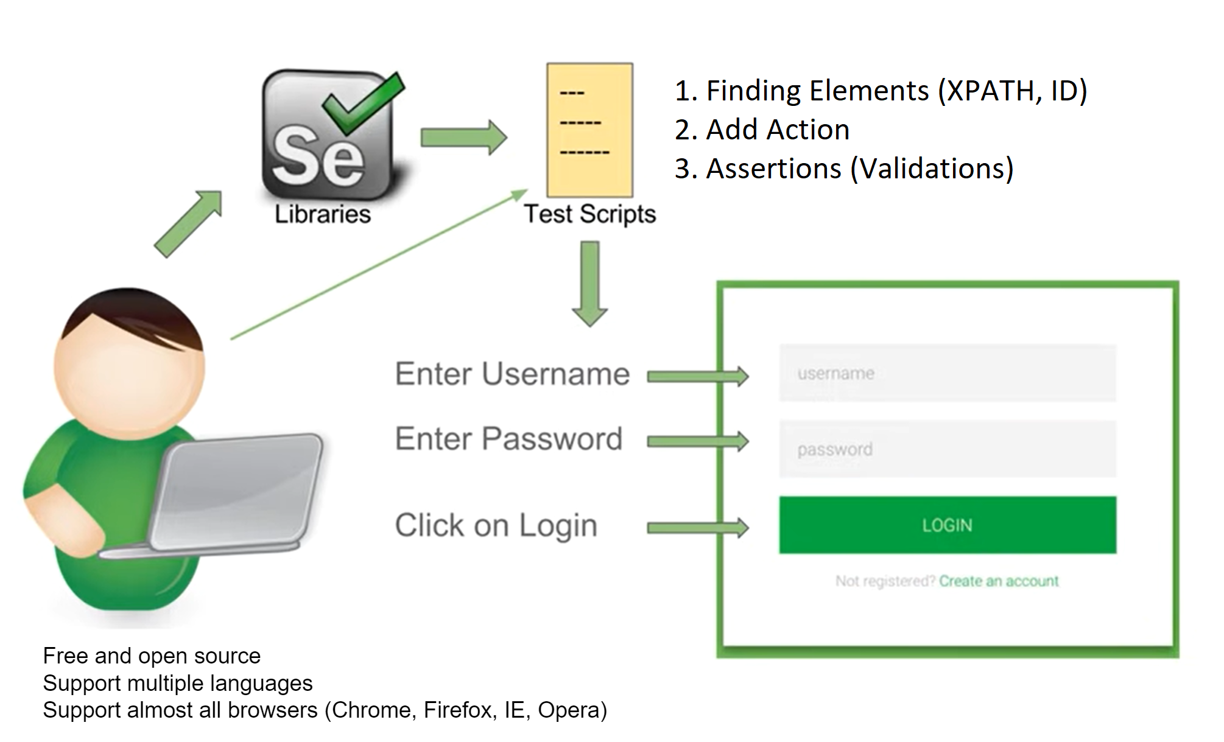
What is Selenium?
Notes:
Free and open source Support multiple languages Support almost all browsers (Chrome, Firefox, IE, Opera)

Slide 4
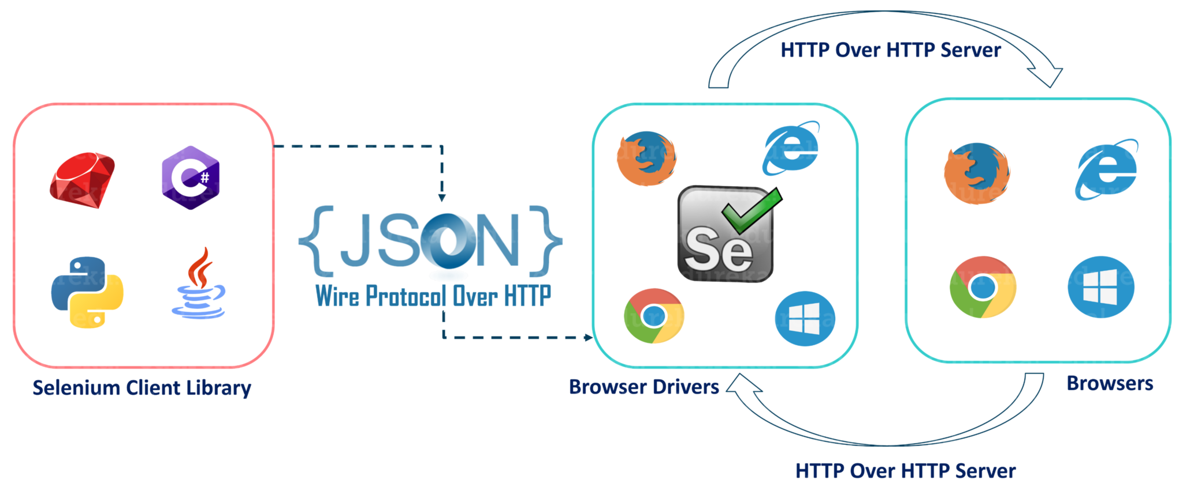
How Selenium works?

Slide 5
First Script!
Install Python
Install Pycharm
Install Selenium Library
First Sample
Some Driver Actions
https://testautomation-playground.herokuapp.com/index.html

Slide 6
Python Fundamentals
Basics and Syntax
Variables
List/Dictionary/Tuple
Strings
Control Flow and Loops (Decision Making)
Functions (Keywords) and Modules
OOP
Some Resources:
https://websitesetup.org/wp-content/uploads/2021/04/Python-cheat-sheet-April-2021.pdf
https://www.tutorialspoint.com/python/index.htm
https://www.youtube.com/playlist?list=PLhW3qG5bs-L9JjtXx-adxWdbjaxeRhi7h
https://www.sololearn.com/learning/1073

Slide 7
Session 2
Create project in Github
WebDriver Manager
requirements.txt
Teardown
Browser Actions
Execute JavaScript Commands
Taking Screenshot
Debugging
Chrome Options

Slide 8
Session 3
DOM and XML?
Strategies:
ID
XPath
Tag
Name
Link Text / Partial Link Text
Class Name
CSS
Chrome Extensions

Slide 9


Slide 10
Xpath
Syntax
Absolute and Relative
Contains
and / or
starts-with
Parent and Tricks
Child and Tricks
Finds / List
Relative / above()
Relative / below()
Relative / toLeftOf()
Relative / toRightOf()
Relative / near()

Slide 11
Session 4 – Xpath (Basics)
Syntax
Absolute and Relative
Attributes (id, name, value, text, class,…)
and / or
Parent & Child
Index
Element as attribute

Slide 13
Absolute XPATH
/html/body/div[3]/div[2]/form/fieldset/input[9]
Relational XPATH
// input [name=‘Options’]

Slide 14
// tag [ condition1 ]
// tag [ condition1 and condition2]
// tag [ condition1 or condition2]
// tag [ (condition1 or condition2) and condition3]
// tag [ condition1 ] /.. #Parent
// tag [ condition1 ] / tag [ condition2 ] # Child
// tag [ condition1 ] // tag [ condition2 ] # Search through children

Slide 15
// tag [ condition1 ] [index]
( // tag [ condition1 ]) [index]
// tag [ tag [ condition1 ] ]
// tag [ .// tag [ condition1 ] ]

Slide 16
Session 5 – Xpath (Functions)
contains()
starts-with()
position()
last()
count()
normalize-space()
translate()
string-length()
round()
floor()
not()
substring-before()
substring-after()

Slide 17
contains()
// * [ contains(text(), 'string')]
// * [ contains(text(), 'string') and @id='some-id']

Slide 18
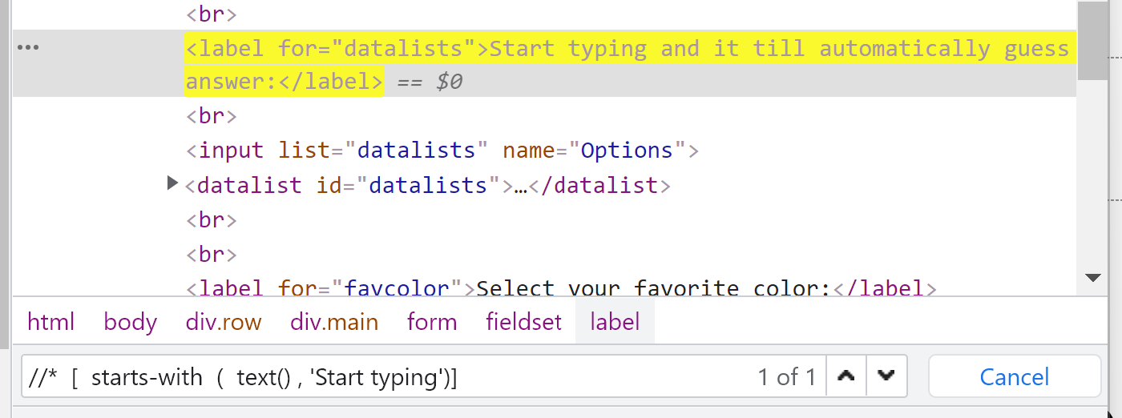
starts-with()
// * [ starts-with(text(), 'string')]

Slide 19
position()
// * [ position() = 3] //starts from 1

Slide 20
last()
// * [ last()]

Slide 21
count()
// tbody [ count (.//tr) = 7 ]

Slide 22
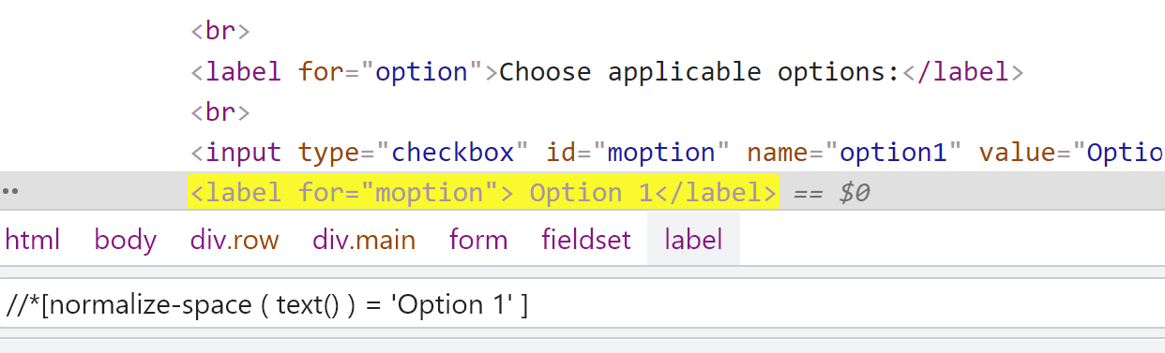
normalize-space()
// *[ normalize-space ( text() ) = 'Option1' ]
// *[ normalize-space (@id) = 'Option1' ]

Slide 23
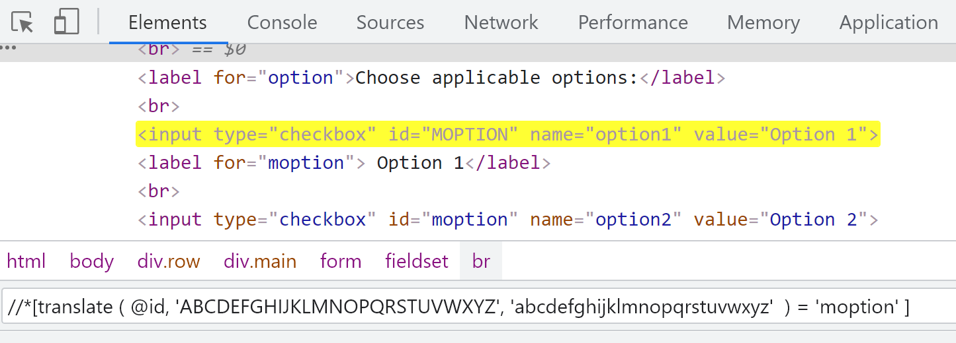
translate()
// *[ translate (text(), 'OPTION', 'option') = 'option1' ]

Slide 24
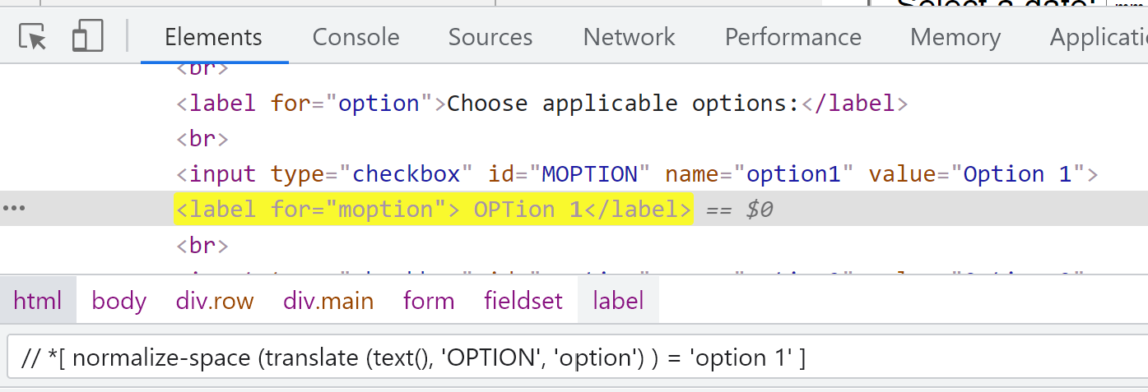
Combine normalize-space() and translate()
// *[ normalize-space (translate (text(), 'OPTION', 'option') ) = 'option1' ]

Slide 25
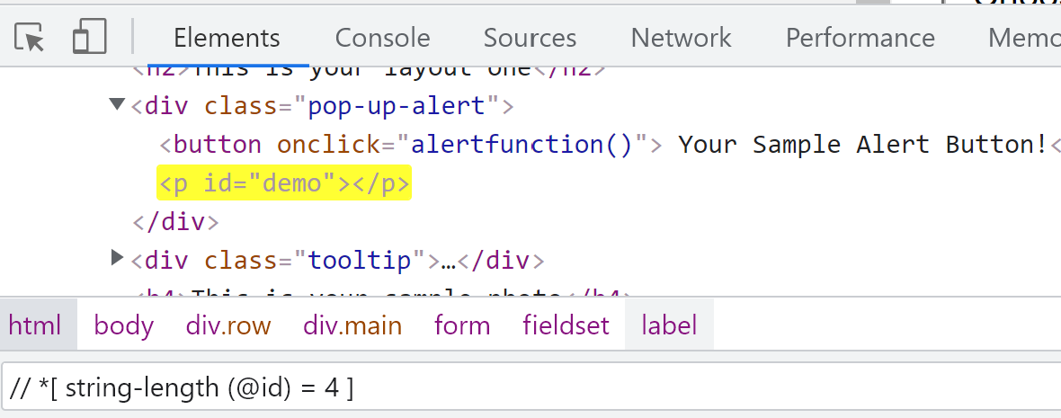
string-length()
// *[ string-length (text()) > 30 ]
// *[ string-length (@id) = 4 ]

Slide 26
round()
// td [ text() = '53.76' ]
OR
// td [ round (text()) = '54']

Slide 27
floor()
// td [ text() = '53.76' ]
OR
// td [ floor (text()) = '53']

Slide 28
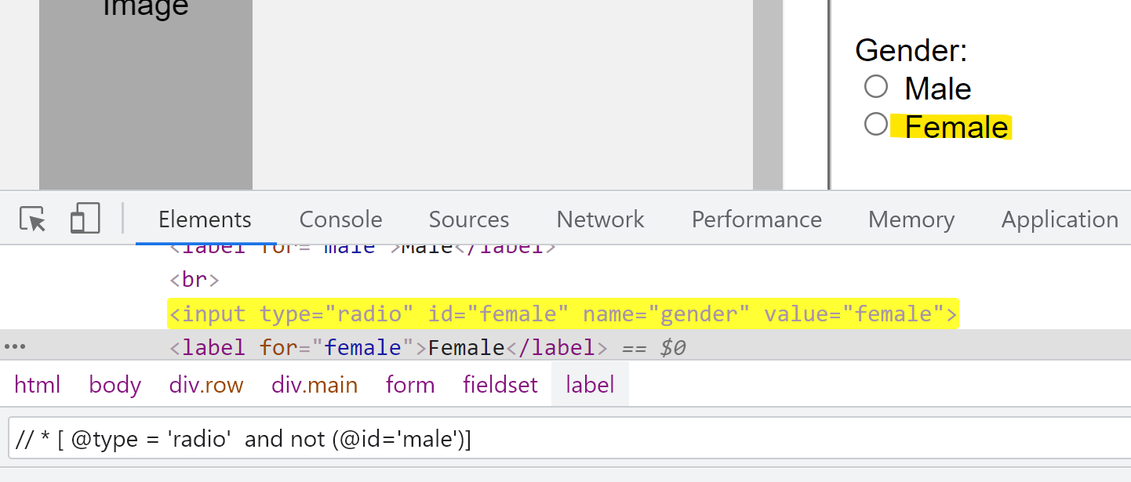
not()
// * [ type() = 'radio' and @id='femail']
OR
// * [ type() = 'radio' and not (@id=‘male')]

Slide 29
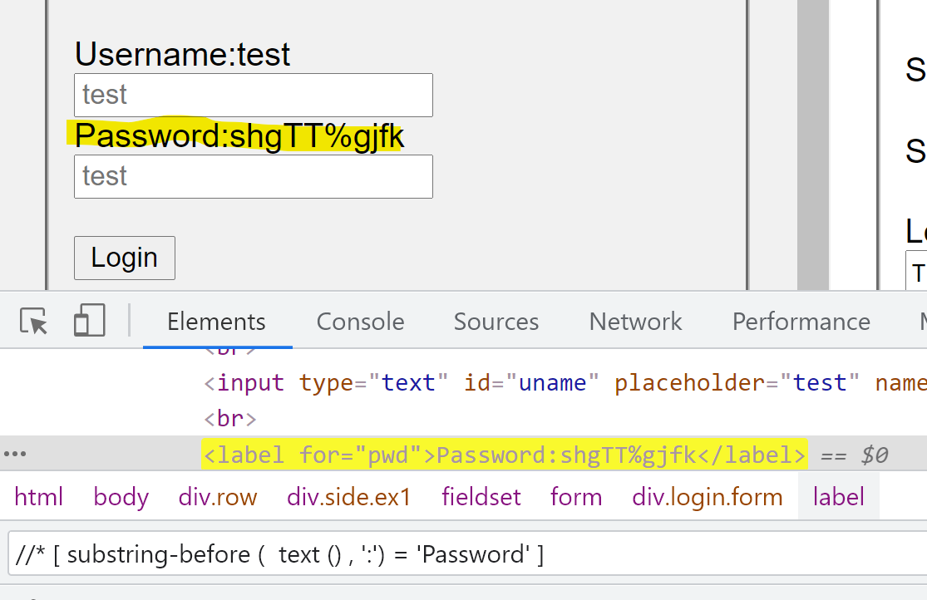
substring-before()
//* [ substring-before ( text () , ':') = 'Password' ]

Slide 30
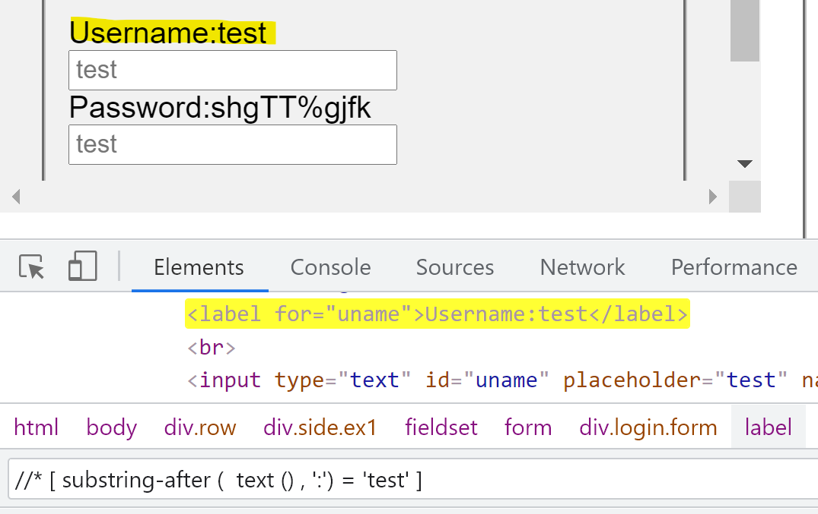
substring-after()
//* [ substring-after ( text () , ':') = 'Password' ]

Slide 31
Session 6 – Xpath (Axes)
parent
ancestor
ancestor-or-self
child
descendent
descendent-or-self
following
following-sibling
preceding
preceding-sibling

Slide 32
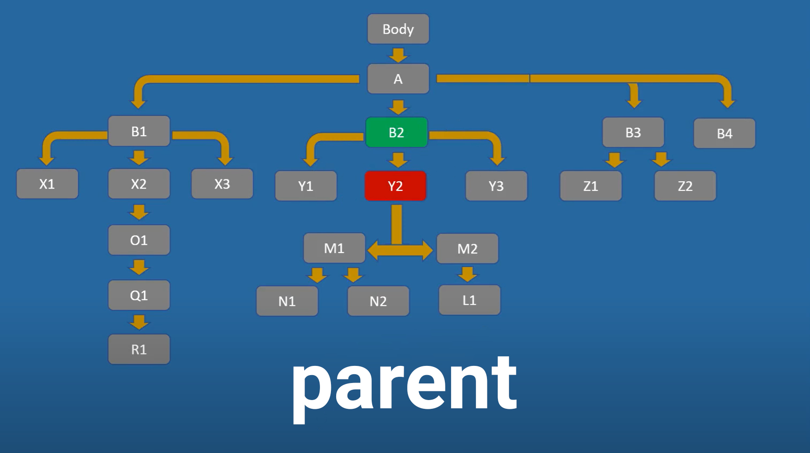
//* [@id=‘abc’] / parent :: *[@id=‘def’]

Slide 33
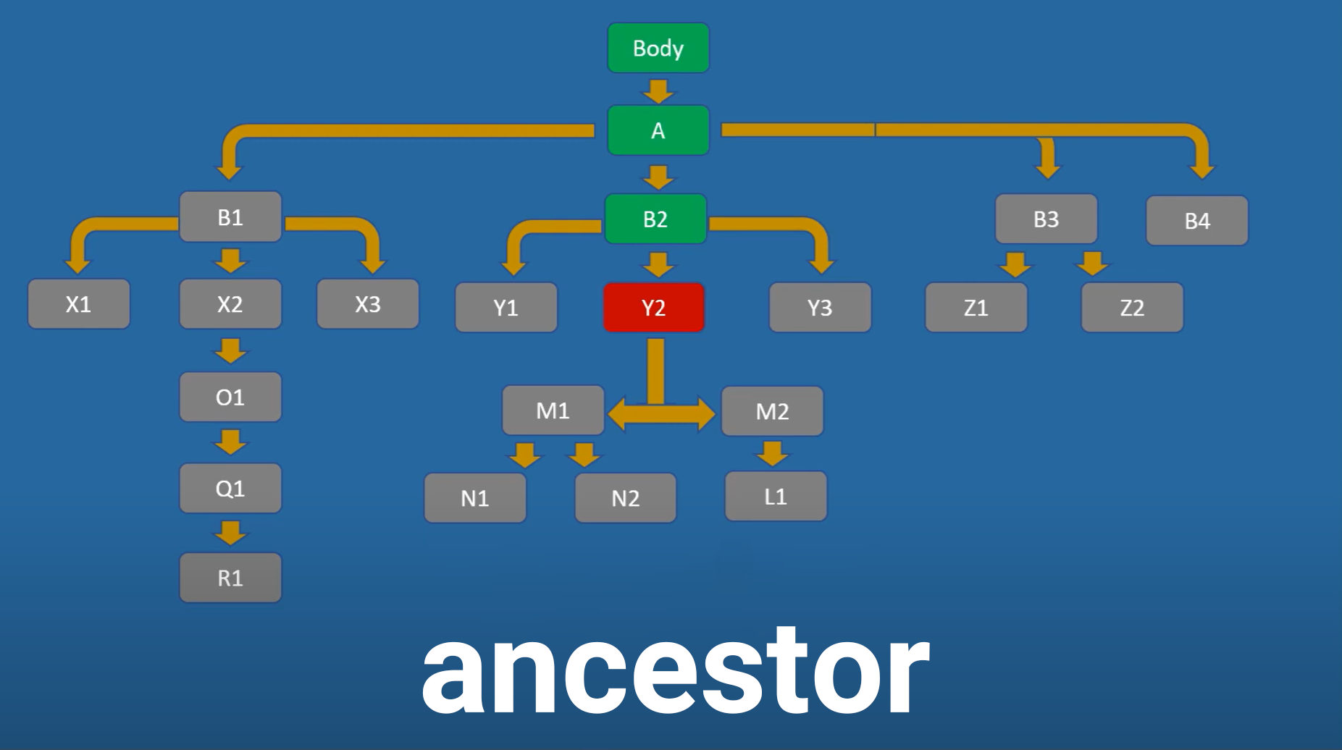
//* [@id=‘abc’] / ancestor :: *[@id=‘def’]

Slide 34
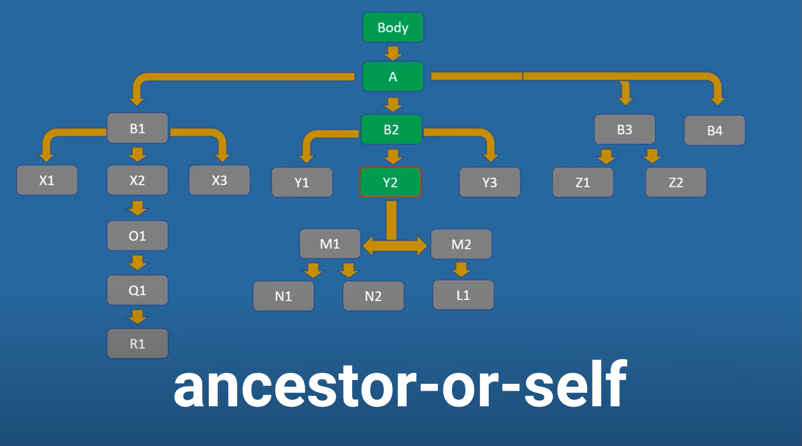
//* [@id=‘abc’] / ancestor-or-self :: *[@id=‘def’]

Slide 35
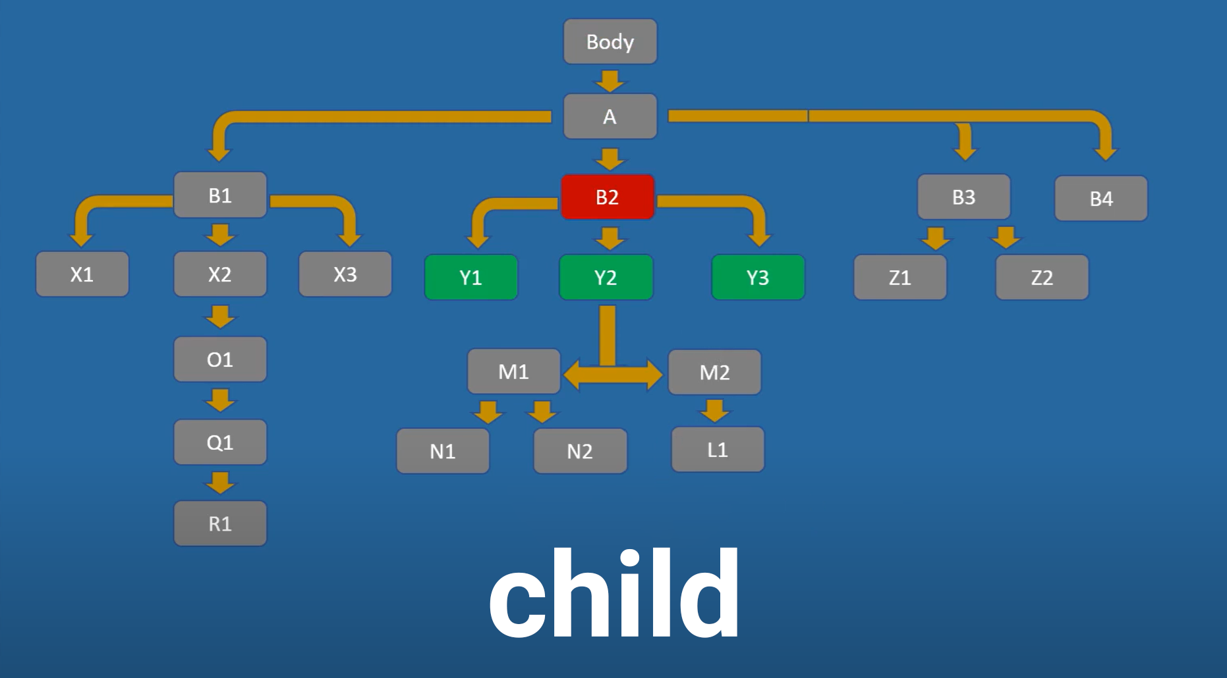
//* [@id=‘abc’] / child :: *[@id=‘def’]

Slide 36
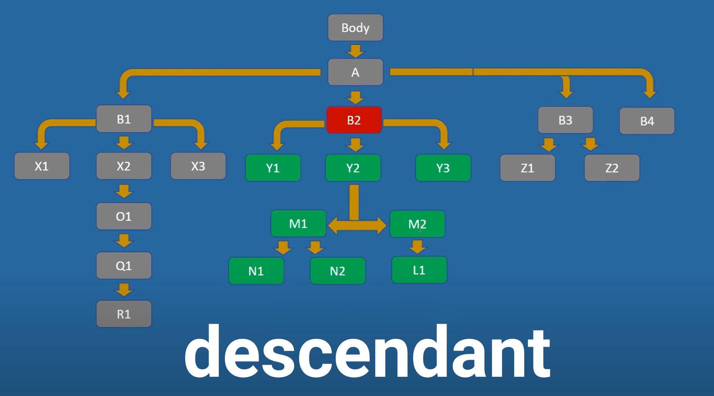
//* [@id=‘abc’] / descendant :: *[@id=‘def’]

Slide 37
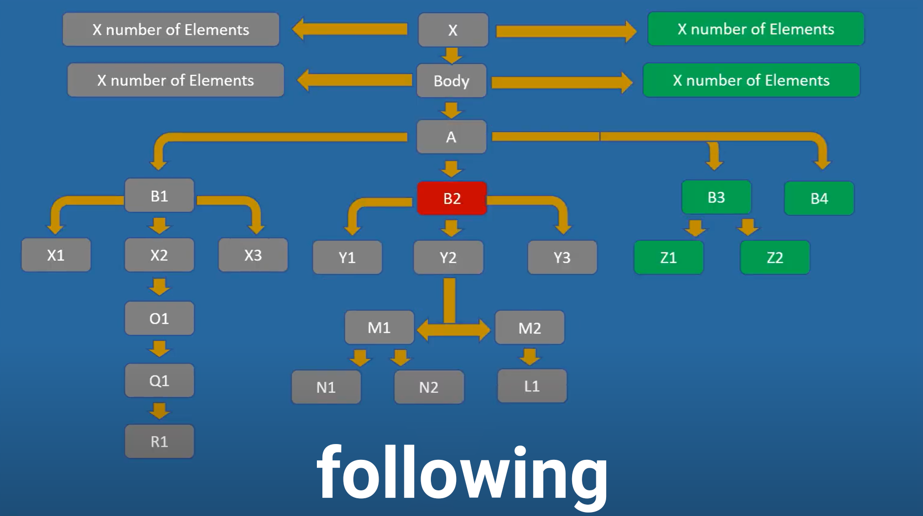
//* [@id=‘abc’] / following :: *[@id=‘def’]

Slide 38
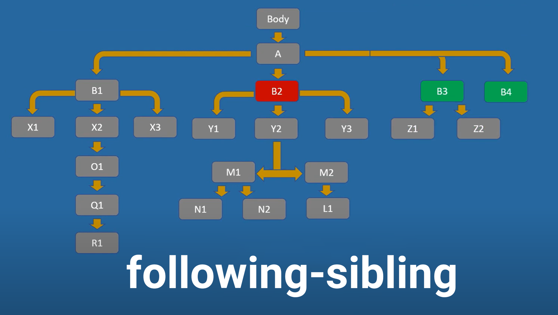
//* [@id=‘abc’] / following-sibling :: *[@id=‘def’]

Slide 39
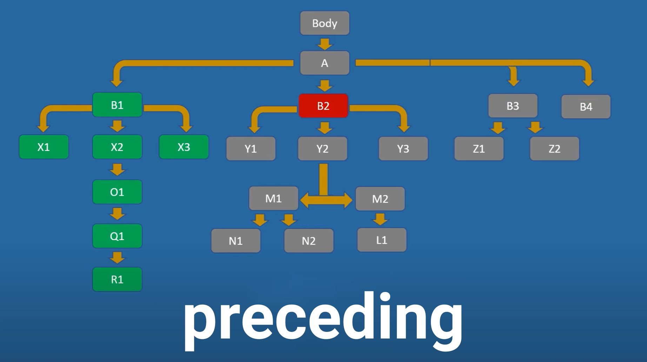
//* [@id=‘abc’] / preceding :: *[@id=‘def’]

Slide 40
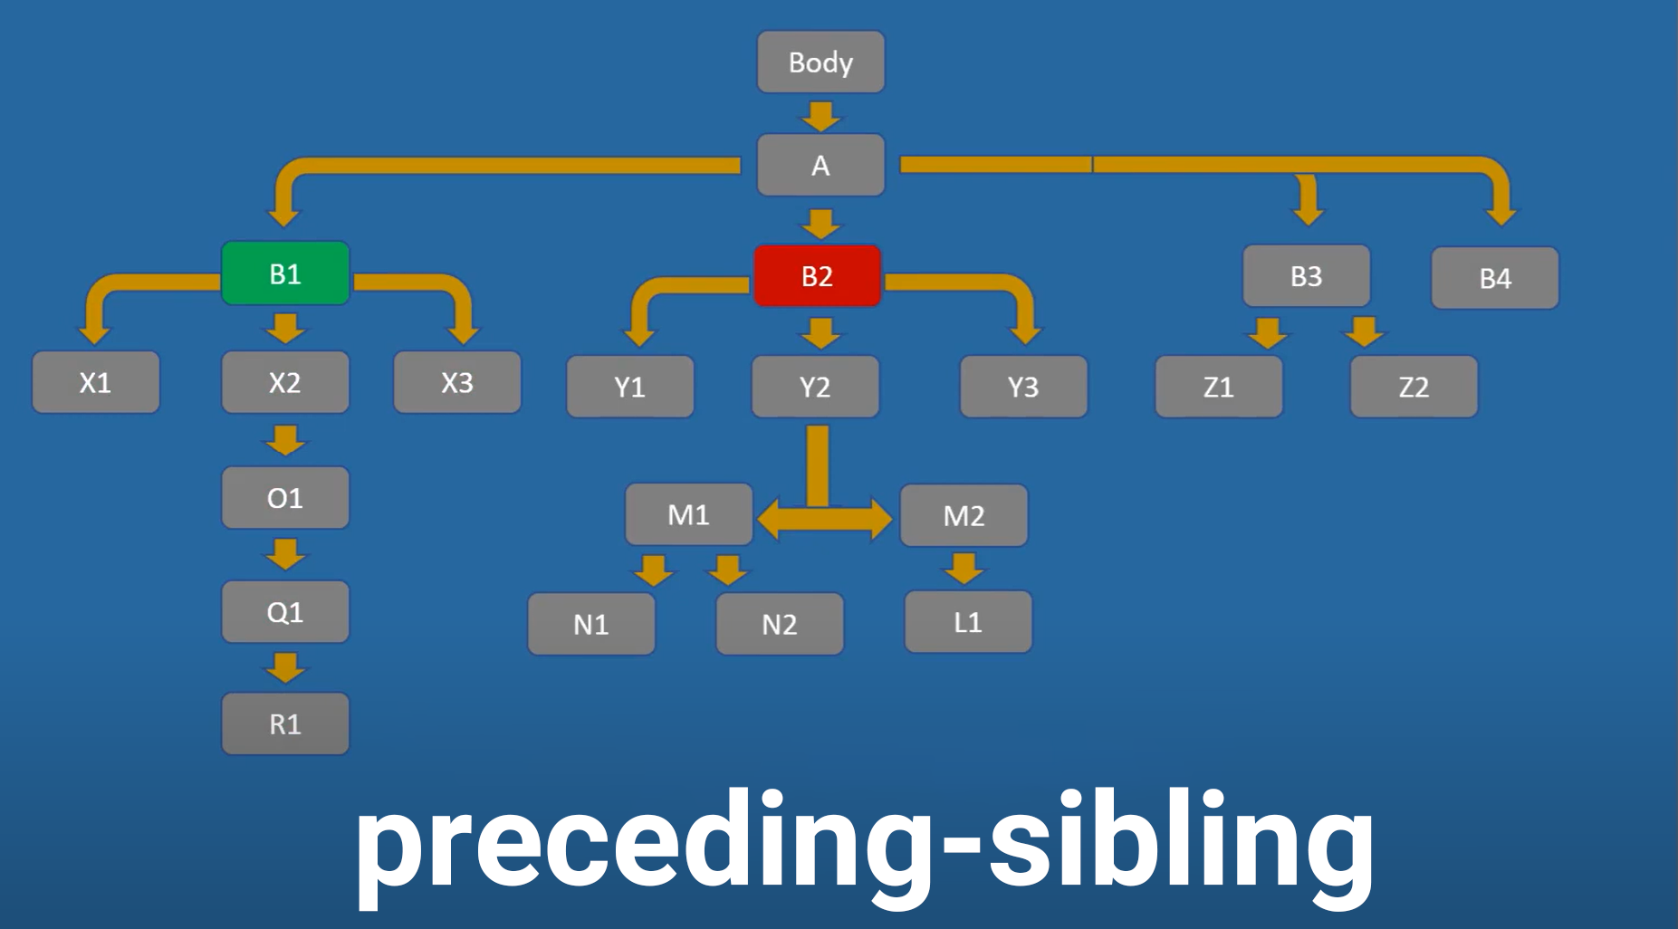
//* [@id=‘abc’] / preceding-sibling :: *[@id=‘def’]

Slide 41
Session 7
Page Object Model
Project Structure
Setup / Default / Teardown
Run using Unittest
HTML Report

Slide 42
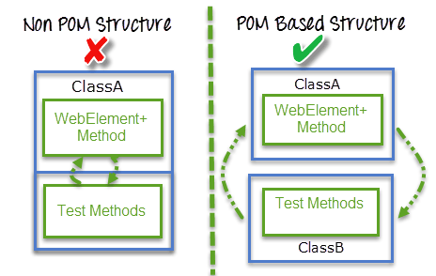
Page Object Model

Slide 43
Session 8 – Keyboard Actions
Typing with Keyboard
Press ENTER
Pressing of Key Combination Like CTRL+ A
Release pressed keys
Clear the text using clear()
Clear the text using CTRL+A+DEL

